Slide 1

COMPUTER PROGRAMMING LANGUAGE
Roll no.53

Slide 2



Content
INTODUCTION-Computer Language
EVOLUTION OF PROGRAMMING
MACHINE LANGUAGE
SYMBOLIC LANGUAGE
HIGH LEVEL LANGUAGE
CONCLUSION
REFERENCE

Slide 3




Introduction-Computer Language
To write a program for a computer , we must use a computer language. Over the years computer languages have evolved from machine language to natural languages

Slide 4

EVOLUTION OF PROGRAMMING

Slide 5
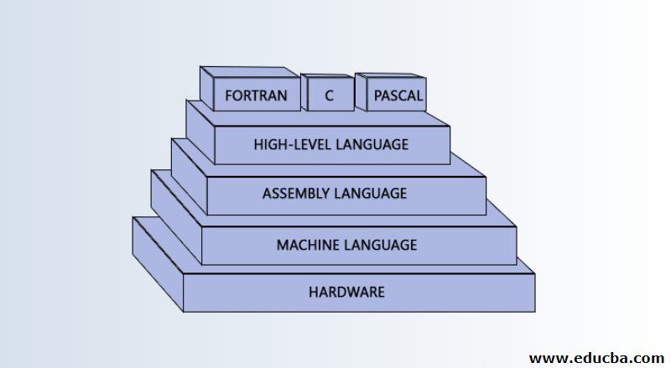

Slide 6
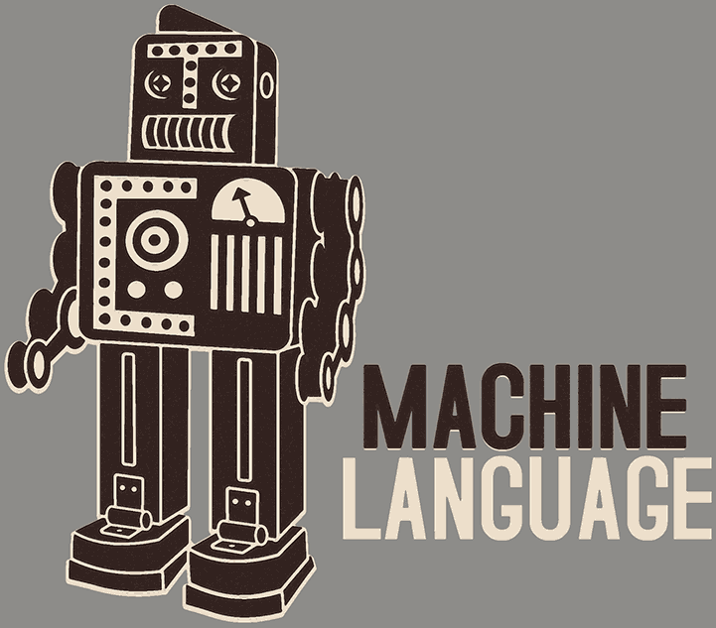
1.MACHINE LANGUAGE
It is a low-level language comprised of binary digits

Slide 7
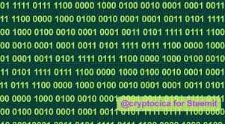

Slide 8

SYMBOLIC LANGUAGE
The language that uses characters or symbols to represent concepts

Slide 9
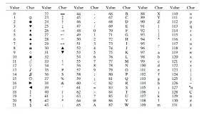

Slide 10
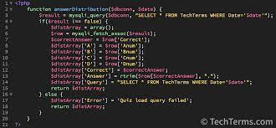
HIGH LEVEL LANGUAGE
A programming language with strong abstraction from the details of the computer

Slide 11
COMMONLY USED HIGH-LEVEL LANGUAGE
Python , Java , C++ , Visual Basic etc

Slide 12

“Code is human . When you have to explain it , it’s bad”
-Cory House

Slide 13

Summary
The evolution of the computer program language has spanned hundreds pf years and has produced the modern internet we use and love.

Slide 14
Reference:
# Wikipedia
# www.learnacademy.org
# devskiller.com

Slide 15


Thank You
Presenter name: Priya Babu
Branch :S2CSEA
Roll no :53

